Slide 1
Machine Management
Juan Armijos​

Slide 2
Idea

Slide 3
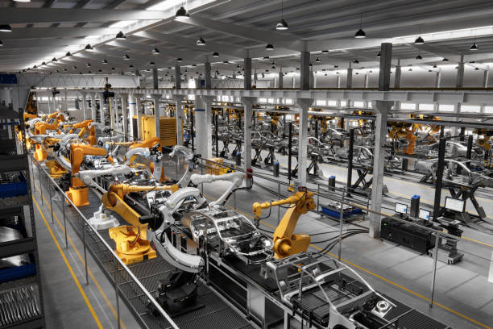


Slide 4
Problem

Slide 5
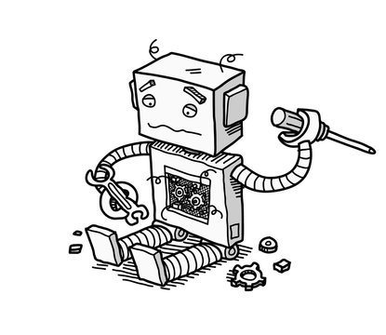

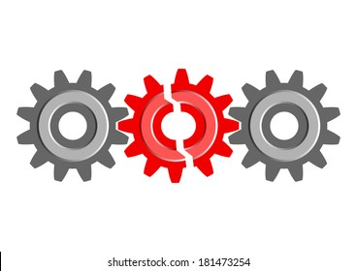

Slide 6
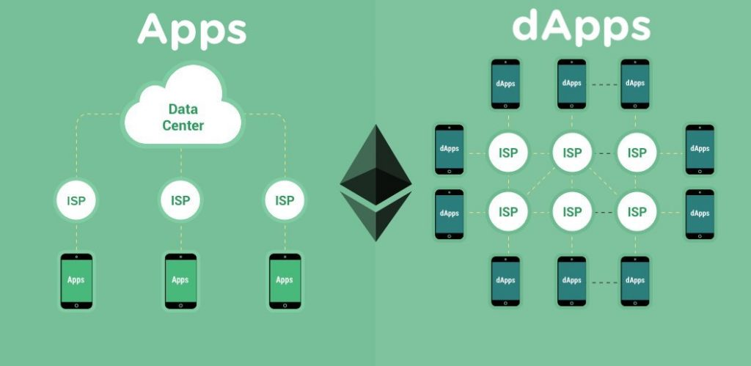
Solution

Slide 7
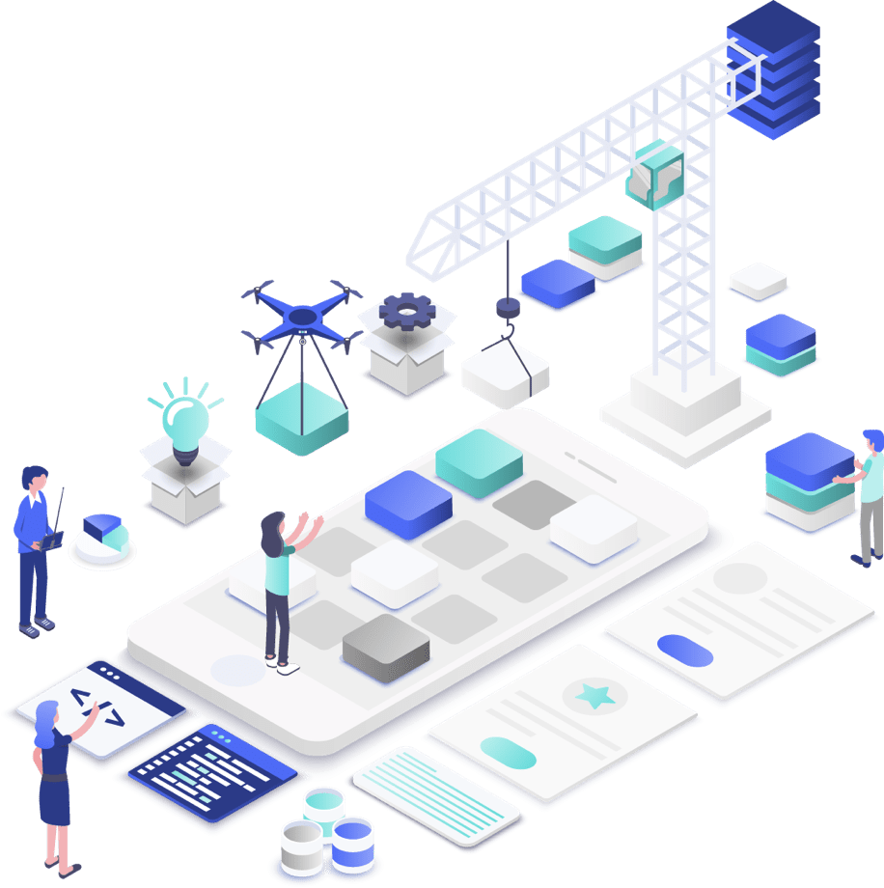
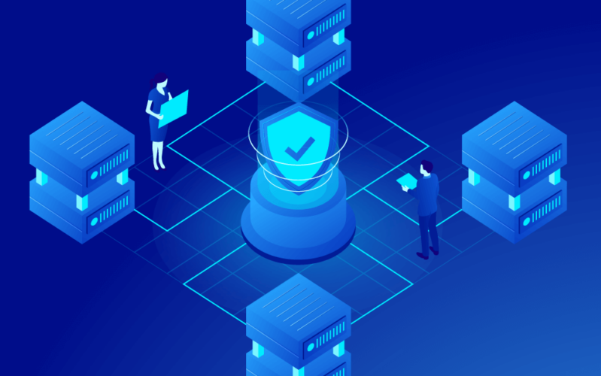
Blockchain and Dapp

Slide 8
How to run it

